Slide 1

Scrum-Agile Approach Facets
There are a few major points of the Scrum-Agile Approach that make it what it is!
We are going to speak about these major facets
and how they are helping all of us in the long run!

Slide 2
Scrum-Agile Approach Facets
Product Owner: The Product Owner is accountable for maximizing the value of the product resulting from the work of the Scrum Team. How this is done may vary widely across organizations, Scrum Teams, and individuals (Schwaber, K. & Sutherland, J., 2020).
Scrum Master: The Scrum Master is accountable for establishing Scrum as defined in the Scrum Guide. They do this by helping everyone understand Scrum theory and practice, both within the Scrum Team and the organization (Schwaber, K. & Sutherland, J., 2020).
Developers: Developers are the people in the Scrum Team that are committed to creating any aspect of a usable Increment each Sprint (Schwaber, K. & Sutherland, J., 2020).
Testers: These are basically Developers that check the Other developer’s work!
There are a few major points of the Scrum-Agile Approach that make it what it is!

Slide 3
THE LIFE CYCLE OF WATERFALL AND WHY IT IS A BAD PRACTICE.
Requirement Analysis
System Design
Implementation
Maintenance
Testing
Deployment
If you run into a problem anytime AFTER any of these steps, You CAN NOT GO BACK. That is why it is called a waterfall. You trickle down each cliff and continue to get dragged downward. This SHOULD ONLY BE USED DURING A DEATH MARCH. https://www.pluralsight.com/blog/career/survive-a-death-march

Slide 4
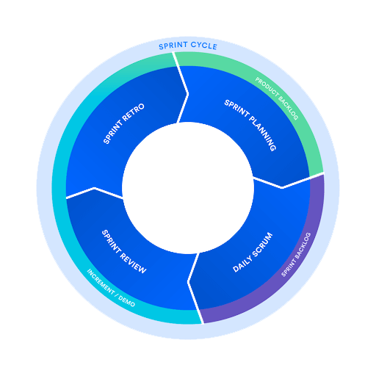
THE SCRUM-AGILE LIFE CYCLE AND WHY IT IS A GOOD PRACTICE.
Scrum is a framework that helps teams work together. Much like a rugby team (where it gets its name) training for the big game, scrum encourages teams to learn through experiences, self-organize while working on a problem, and reflect on their wins and losses to continuously improve.
While the scrum I’m talking about is most frequently used by software development teams, its principles and lessons can be applied to all kinds of teamwork. This is one of the reasons scrum is so popular. Often thought of as an agile project management framework, scrum describes a set of meetings, tools, and roles that work in concert to help teams structure and manage their work. (Drumond, C., 2022).

Slide 5


In Review
SCRUM-AGILE is a revolutionary Methodology that can will be used for MANY years to come!
With it, you can equalize all work and minimize the problems that go wrong with the Waterfall Methodology.
I hope this has helped you understand! Thank You.
REFERENCES
On next slide!

Slide 6
REFERENCES
Drumond, C. (2022). Scrum - what it is, how it works, and why it's awesome. Atlassian. Retrieved February 12, 2022, from https://www.atlassian.com/agile/scrum
Schwaber, K., & Sutherland, J. (2020). The 2020 scrum GUIDE. Scrum Guide | Scrum Guides. Retrieved February 12, 2022, from https://scrumguides.org/scrum-guide.html#developers

